Slide 1
Eating Around Toronto
Exploration of Restaurants Clustering in the City of Toronto

Slide 2
Understand the City’s Gourmet Map
Give you an overall view of Toronto restaurants distribution and try to identify the possible clustering in its cosmopolitan areas.
Give guidance about the location selection regarding opening a restaurant

Slide 3
Data Acquisition and Cleaning
Data sources:
url=‘https://en.wikipedia.org/wiki/List_of_postal_codes_of_Canada:_M’
API: www.foursquare.com/developers/
Geocoder library to extract the coordinates information

Slide 4
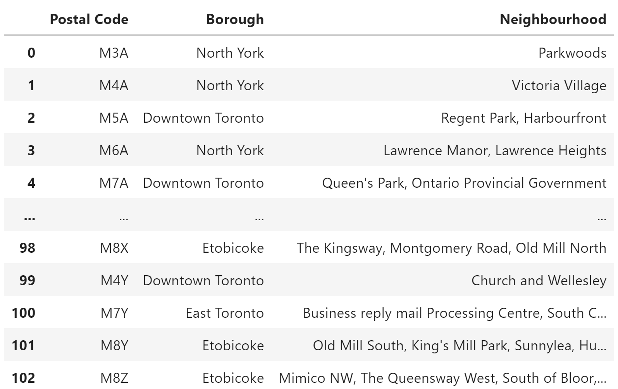
Postal code of every borough and neighborhood :

Slide 5
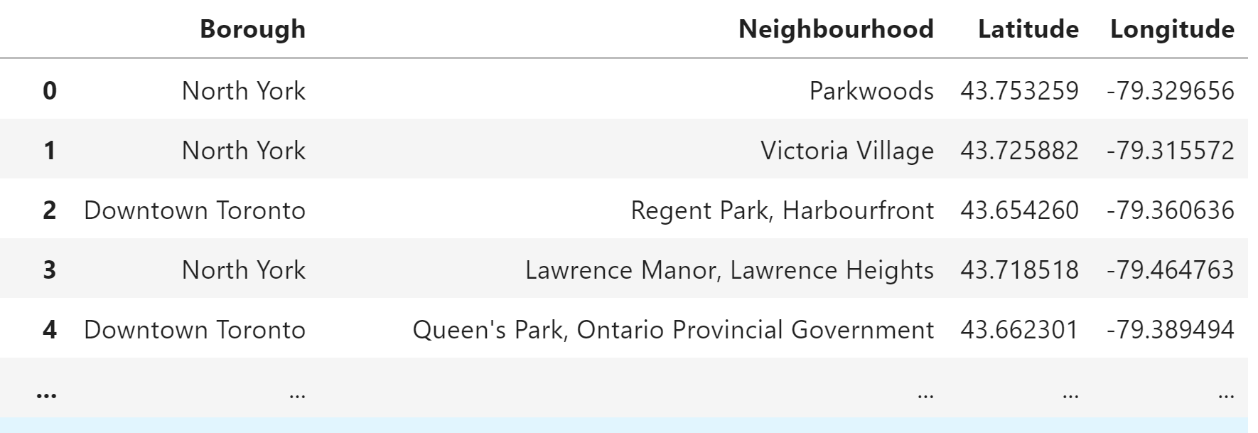
Get the coordinations:

Slide 6
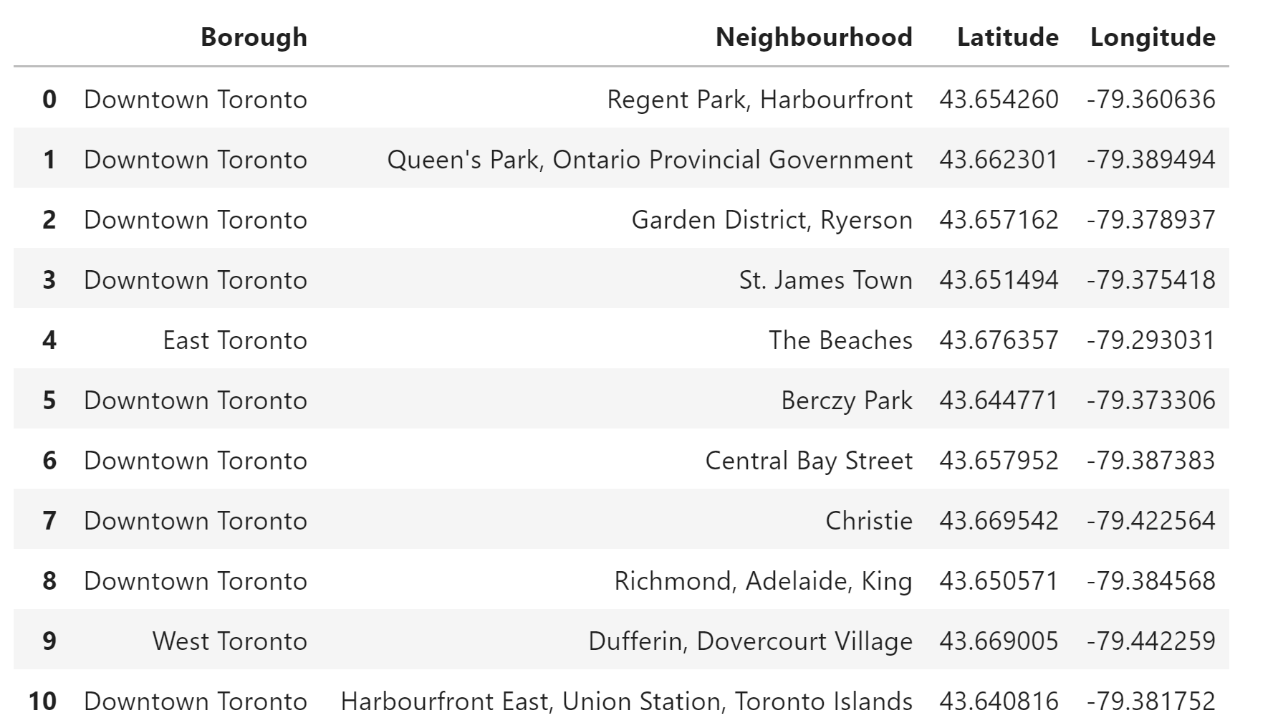
Extract those neighbourhoods with ‘Toronto':

Slide 7
Searching for restaurants - API
Get the nearby restaurants in every neighborhoods using 'query=restaurant'
url = 'https://api.foursquare.com/v2/venues/search?&client_id={}&client_secret={}&v={}&ll={},{}&radius={}&limit={}&query=restaurant’. format
CLIENT_ID,
CLIENT_SECRET,
VERSION,
neighborhood_latitude ,
neighborhood_longitude ,
radius,
LIMIT)

Slide 8
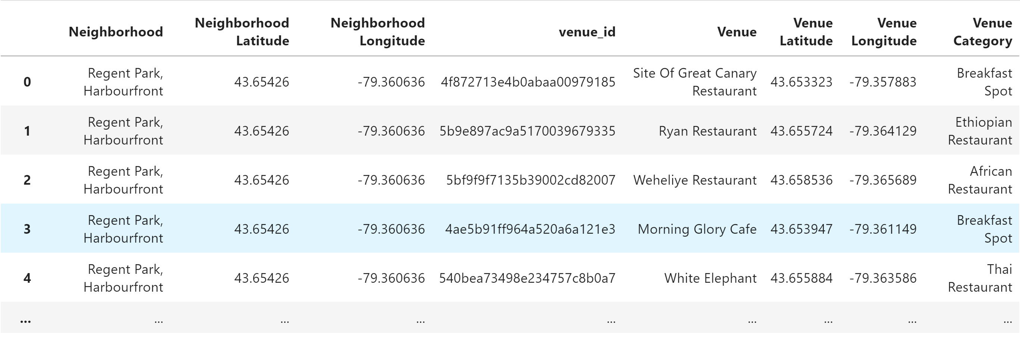
Get the nearby restaurants in every neighborhoods and the restaurant’s category

Slide 9
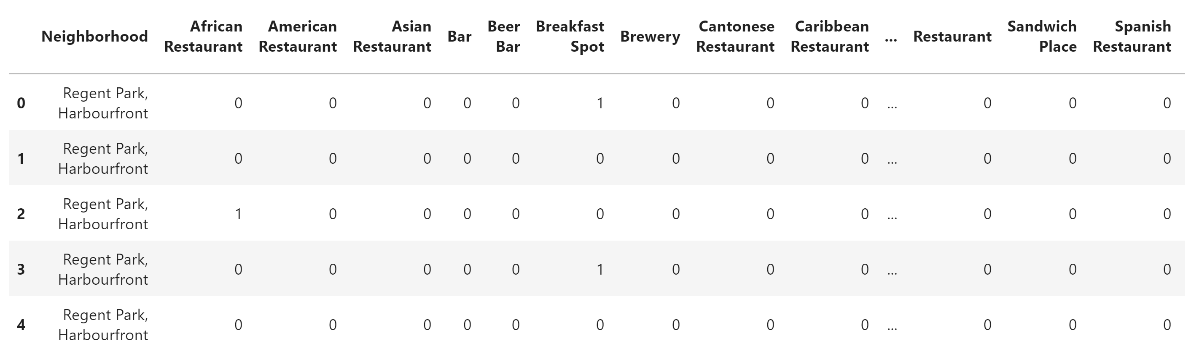
Get_dummies()

Slide 10
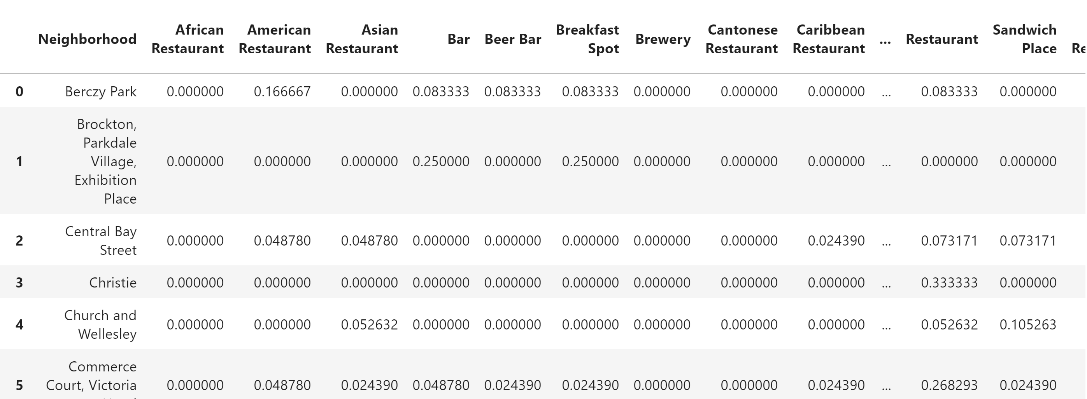
Get Average number of each category in every neighborhood

Slide 11
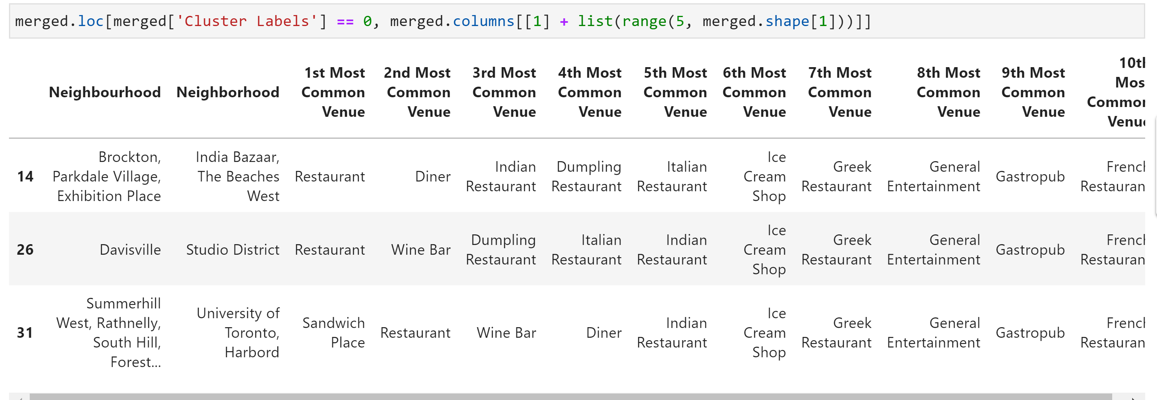
K-Means Model:
Cluster 1:(3 neighborhoods)

Slide 12
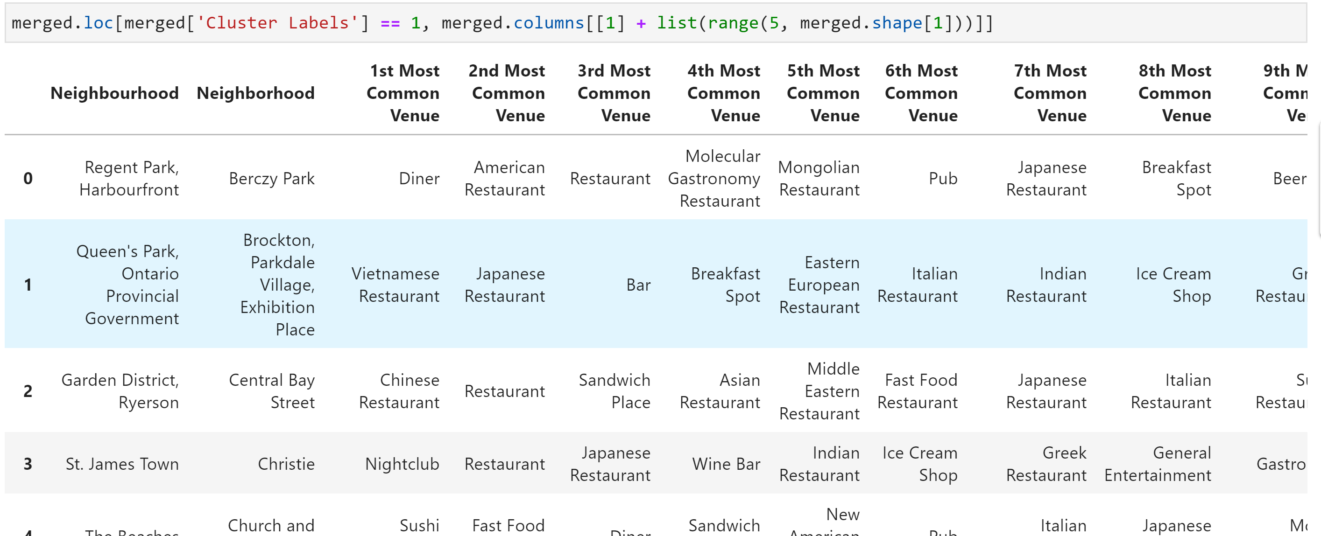
K-Means Model:
Cluster 2 (28 neighborhoods)

Slide 13
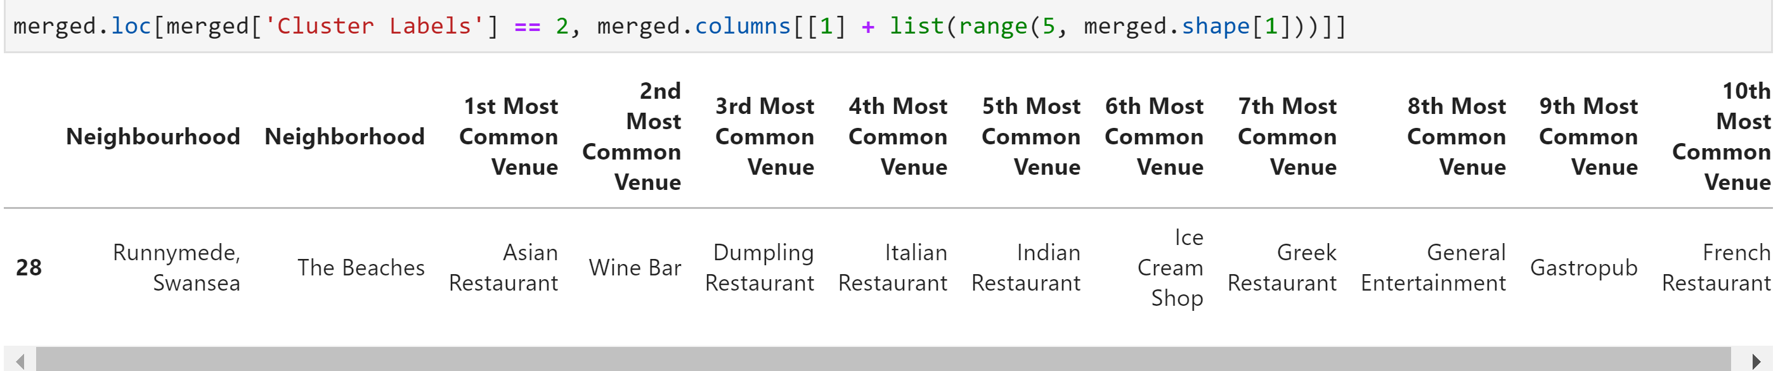
K-Means Model:
Cluster 3: (only 1 neighborhood)

Slide 14
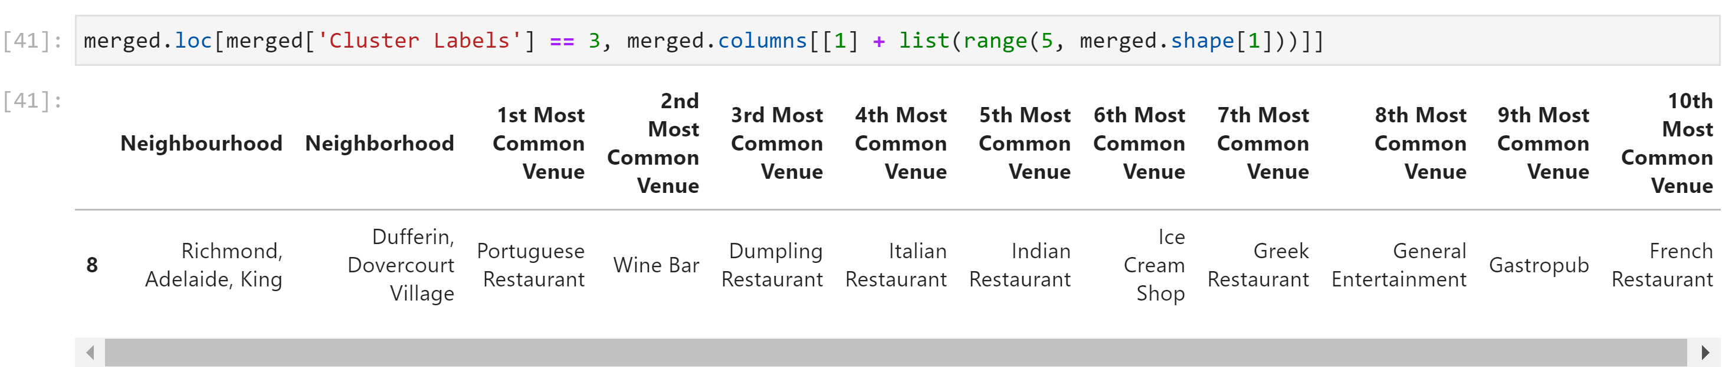
K-Means Model:
Cluster 4: (only 1 neighborhood)

Slide 15
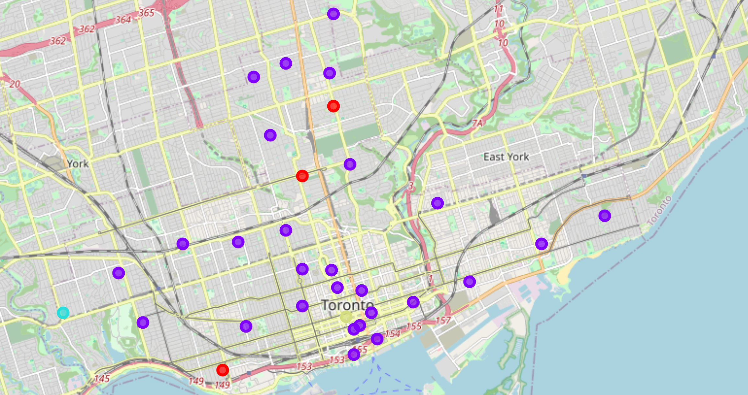
Toronto Restaurants Clusters:

